Slide 1

Enhancing Conversational AI Model Performance and Explainability for Sinhala-English Bilingual Speakers
2022-056
Progress Presentation - II

Slide 2


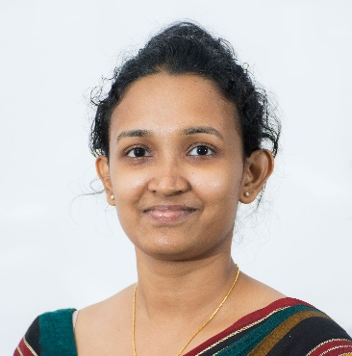




The Team
Supervisor
Dr. Lakmini Abeywardhana
Co – Supervisor
Ms. Dinuka Wijendra
Dissanayake D.M.I.M.
IT19069432
(Explainable AI)
Hameed M.S.
IT19064932
(Codeless Interface)
Jayasinghe D.T.
IT19075754
(Language & Interactions)
Sakalasooriya S.A.H.A.
IT19051208
(Entity Annotation)

Slide 3
kolloqe

Slide 4











Sysyem Architecture
Code-switchable Keyboard
Rule-based keyboard interface
socket io
Deployed Rasa Model
Chat Widget
End Users
Entity Annotating
Reverse Stemming, N-grams, Cosine Similarity
Machine Learning Pipeline Improvements
JS, YAML
Developers
& Testers
Accuracy Curves
TensorBoard, JS
Intent Classification Model Explanations
DIME, Feature Importance
Development Console
Trained Rasa Models
https

Slide 5

98%
SIENA: Annotating entities using
reverse-stemming & other techniques
to develop a data annotation tool for code-mixed text data for efficient custom entity tagging.
Sakalasooriya S.A.H.A.
IT19051208
Data Science

Slide 6




Research Problem
Why custom name entity tagging is very time consuming?💤🥱
Any solution?
🤔

Slide 7
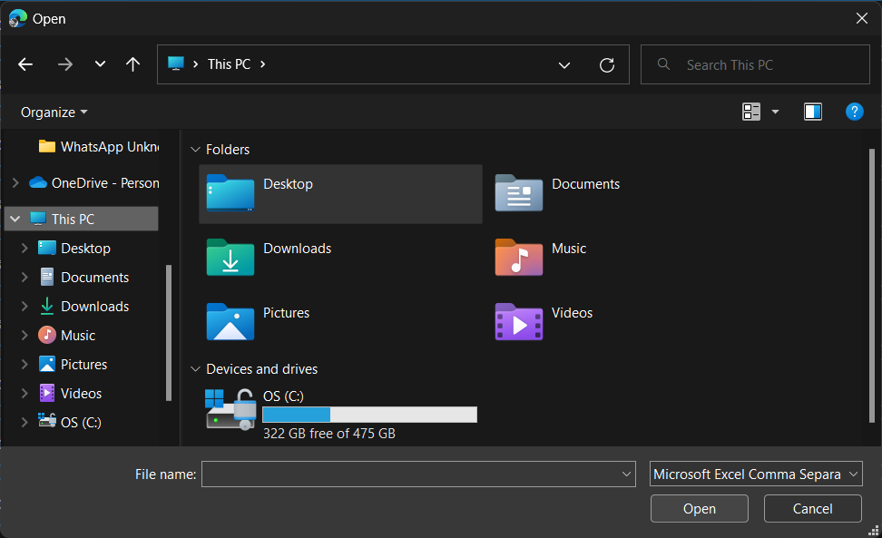
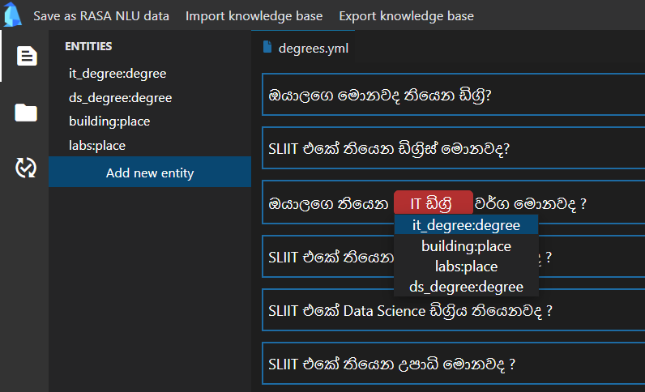
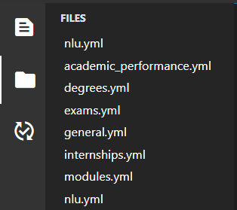
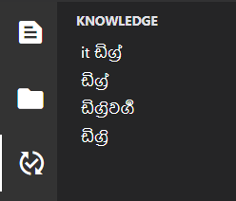
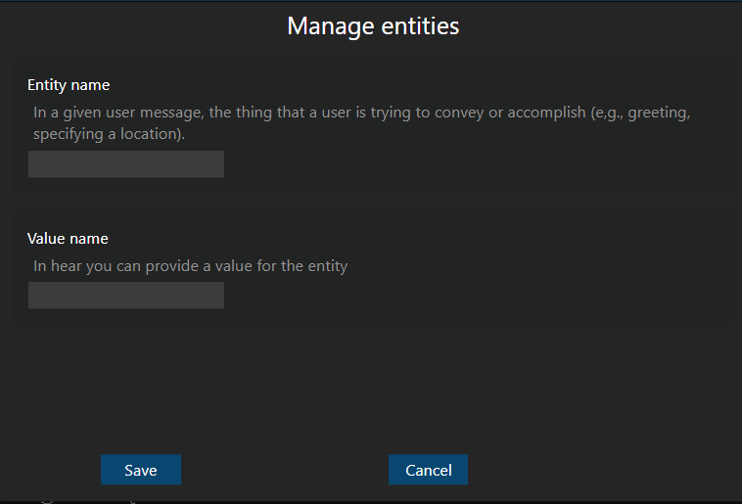

Solution

Slide 8





Functional Requirements
Recommend name entities
Import corpus into SINEA
Export annotated text from SIENA
Import portable knowledge base into SINEA
Export portable knowledge base from SINEA

Slide 9
Non-functional Requirements
Make as a SIENA secure software
Able to easily maintain
Easily install
SIENA should be reliable
Compatibility

Slide 10







Solution Flow
config.SIENA
Stemming
Stemmed word list
}
Find similar words
Rasa NLU data extractor
SIENA UI
🔍
entities.SIENA
Bot dataset
Provide suggestions
inprogress.SIENA
User
SIENA Server

Slide 11
Methodology Reverse stemming
IT ඩිග්‍රිවල
IT ඩිග්‍රියක
2
3
IT ඩිග්‍රි: deg_type
1
Stem “IT ඩිග්‍රිවල” into base word and map it to the given entity type
1
2
Stem “IT ඩිග්‍රියක” into base word and get entity type of base word
3
Suggest entity type of base word to “IT ඩිග්‍රියක”

Slide 12
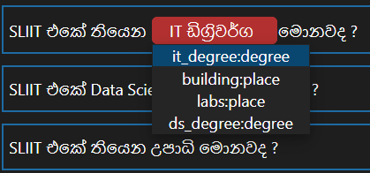
Sort recommendations according to the similarly
Cosine similarly
}
Highest score
Score
Least score
Base word list
N- gram similarly
Slightly different base forms due to:
Spelling mistakes
Different Singlish typing patterns
Limitations of stemming algorithm

Slide 13
Sub Objectives
100% * 0.4
100% * 0.2
Define the Recommendation hierarchy (algorithms)
Make SIENA Compatible with Frameworks
100% * 0.1
94% * 0.3
Make Knowledge base as Moduler Component
Develop Visualizations Technique to Provide User Friendly Suggestions
98%
Overall completion = (objective completion) x (objective weight) =

Slide 14
Work Breakdown Structure
SIENA
1
Data Preparation
2
Algorithm Development
3
SIENA Development
NER model Implementation
Deployment
4
5
Data Collection
Revere stemming approach development
SIENA CLI
Build NLP pipeline
Update the GIT Repository
Data Augmentation
SIENA GUI
Build NER model
Set up cloud Instance
Word-wise cosine similarity approach development
Data Deduplication
Flask server implementation
Deploy SIENA
Data Preprocessing
SIENA user testing
N-gram approach development
Implement SIENA documentation
Algorithm evaluation
Completed
In-progress (90% - 100%)
Pending

Slide 15




Technologies
Backend Development
Frontend Development
Project Management
Python
pandas
HTML
Git
GitLab
GitHub
Rasa
Flask
PyPI
Test PyPI
Secure flask server
.SIENA files to save configuration data

Slide 16

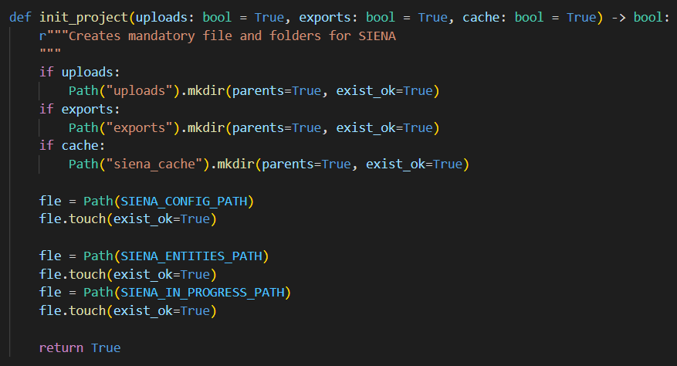
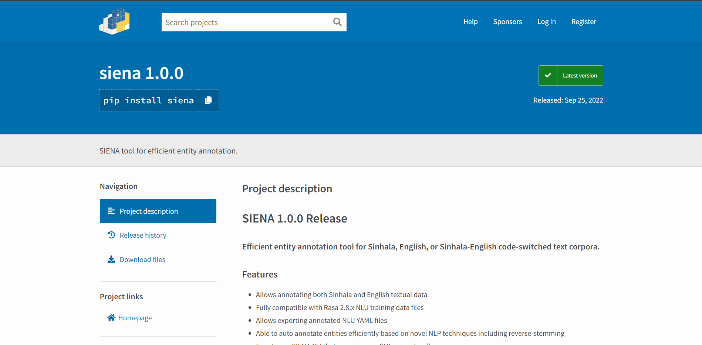
Best practices
Docstrings & PEP-8 Style
Available on pypi

Slide 17
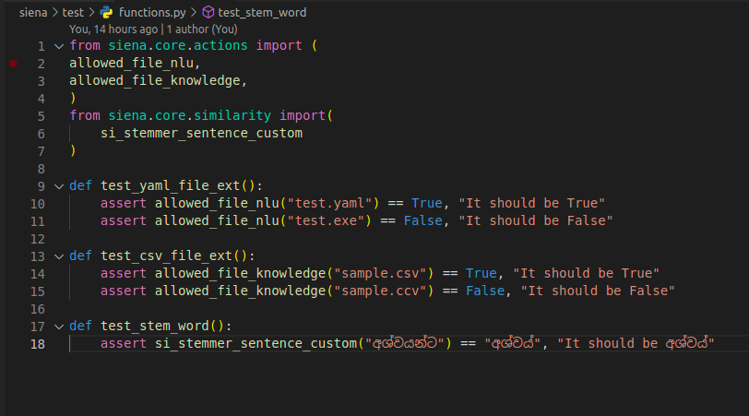
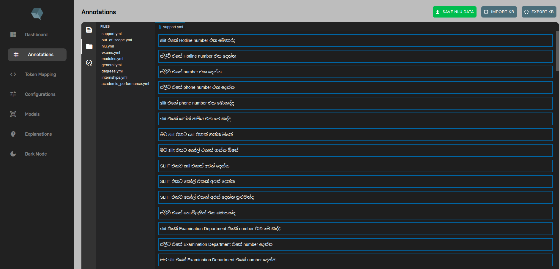
Testing
Unit testing
Integration testing

Slide 18
References
[1] Anastasia Zhukova, Felix Hamborg, Bela Gipp, ‘ANEA: Automated (Named) Entity Annotation for German Domain-Specific Texts’ Available: https://arxiv.org/pdf/2112.06724.pdf
[2] Pontus Stenetorp, Sampo Pyysalo, Goran Topic, Tomoko Ohta, Sophia Ananiadou, and Jun’ichi Tsujii, ‘BRAT: a Web-based Tool for NLP-Assisted Text Annotation’ Available: https://aclanthology.org/E12-2021.pdf
[3] Kalina Bontcheva, Hamish Cunningham, Ian Roberts, Angus Roberts, Valentin Tablan, Niraj Aswani, Genevieve Gorrell, ‘GATE Teamware: a web-based, collaborative text annotation framework’, Available: https://www.jstor.org/stable/42636386
[4] Jie Yang, Yue Zhang, Linwei Li, Xingxuan Li, ‘YEDDA: A Lightweight Collaborative Text Span Annotation Tool’, Available: https://aclanthology.org/P18-4006.pdf
[5]J.B Dissanayake, Basaka mahima, ISBN: 9789556963656
[6] "Spacy Styleguide",
https://spacy.io/styleguide
[7] "Spacy Data formats · spaCy API Documentation",
https://spacy.io/api/data-formats
[8] "Vector Icons and Stickers - PNG, SVG, EPS, PSD and CSS",
https://www.flaticon.com/

Slide 19
99%
Code-less Maintenance and
Model Performance Evaluation
Enabling non-machine learning experts to effectively improve and evaluate conversational AI machine learning models
Hameed M.S.
IT19064932
Software Engineering

Slide 20






Implemented Research
Component Flow
ML Pipeline and Policy Maintenance
Trained Models
Configure pipeline and policy components using the GUI
config.yml
Development & Maintenance User Interface
Create a JSON object with the config file components which include the pipeline and policy configurations
Train model using Flask server
Developers and Testers
View or download trained models
from the GUI
Trained RASA Model
View learning curves and provided evaluations for loss curve
Best epoch calculated using LCE

Slide 21

Model Improvement
Existing Solution

Slide 22
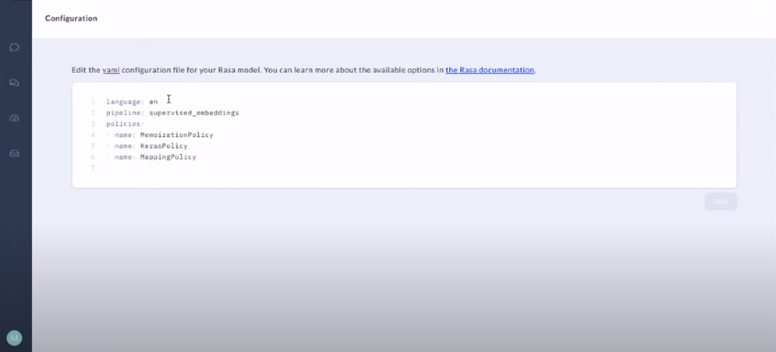
Rasa X
Solution

Slide 23
Model Improvement
Proposed Solution

Slide 24

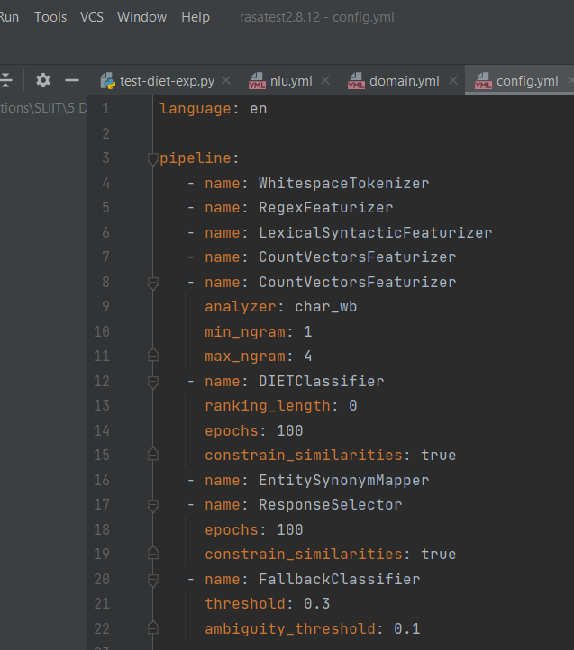


Modify Rasa NLU Configurations
Select an Intent Classifier:
DIET Classifier
Advanced Component Configurations:
Epochs
Ranking Length
Train

Slide 25
Model Improvement
Implemented Solution

Slide 26
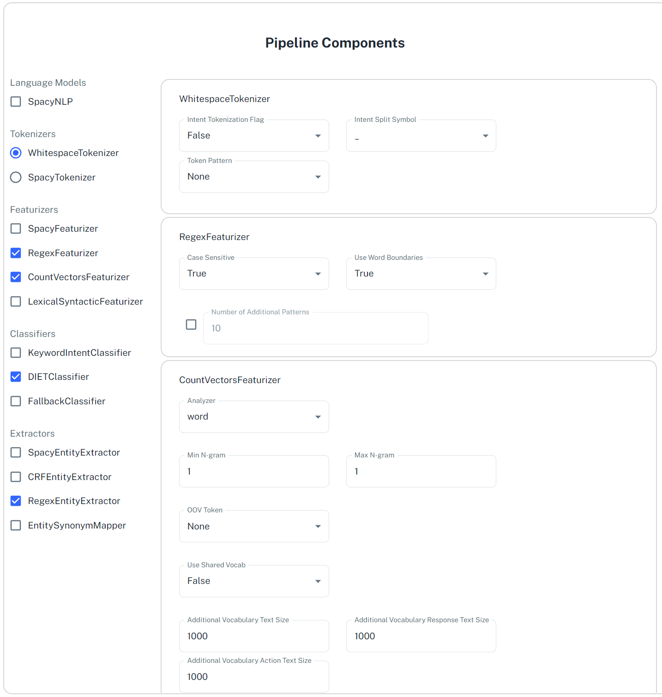
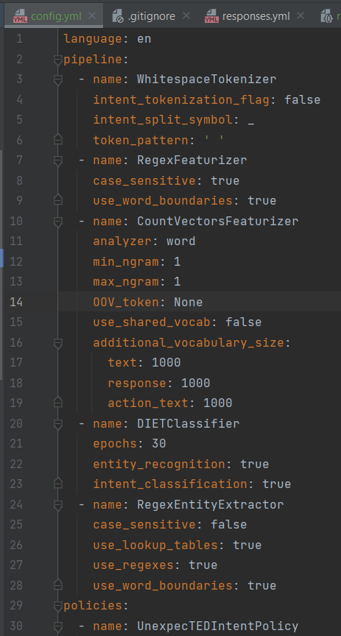
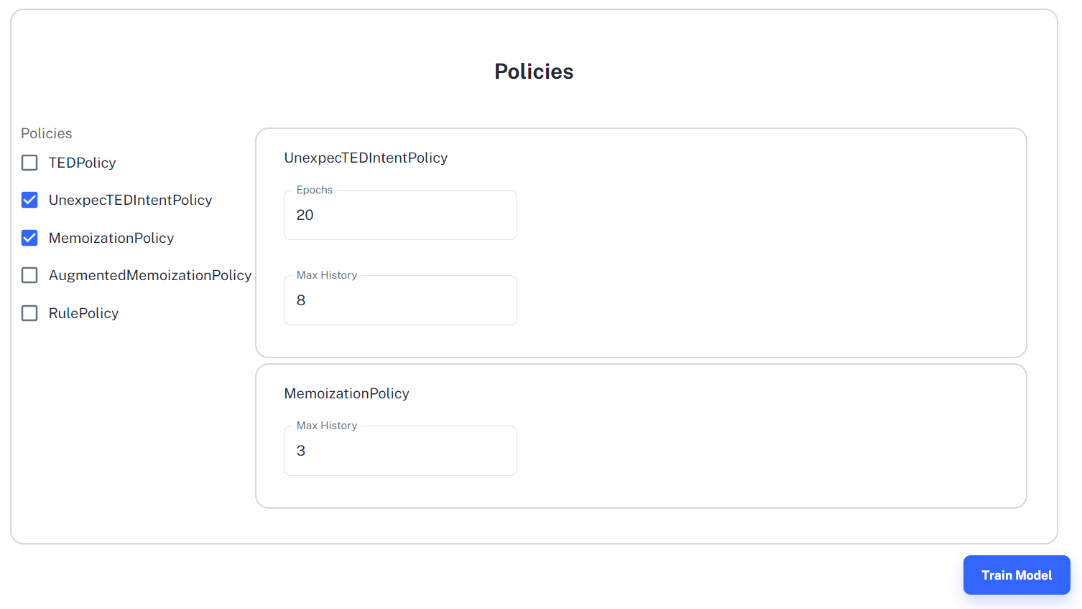
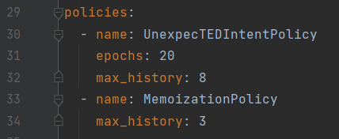

Slide 27
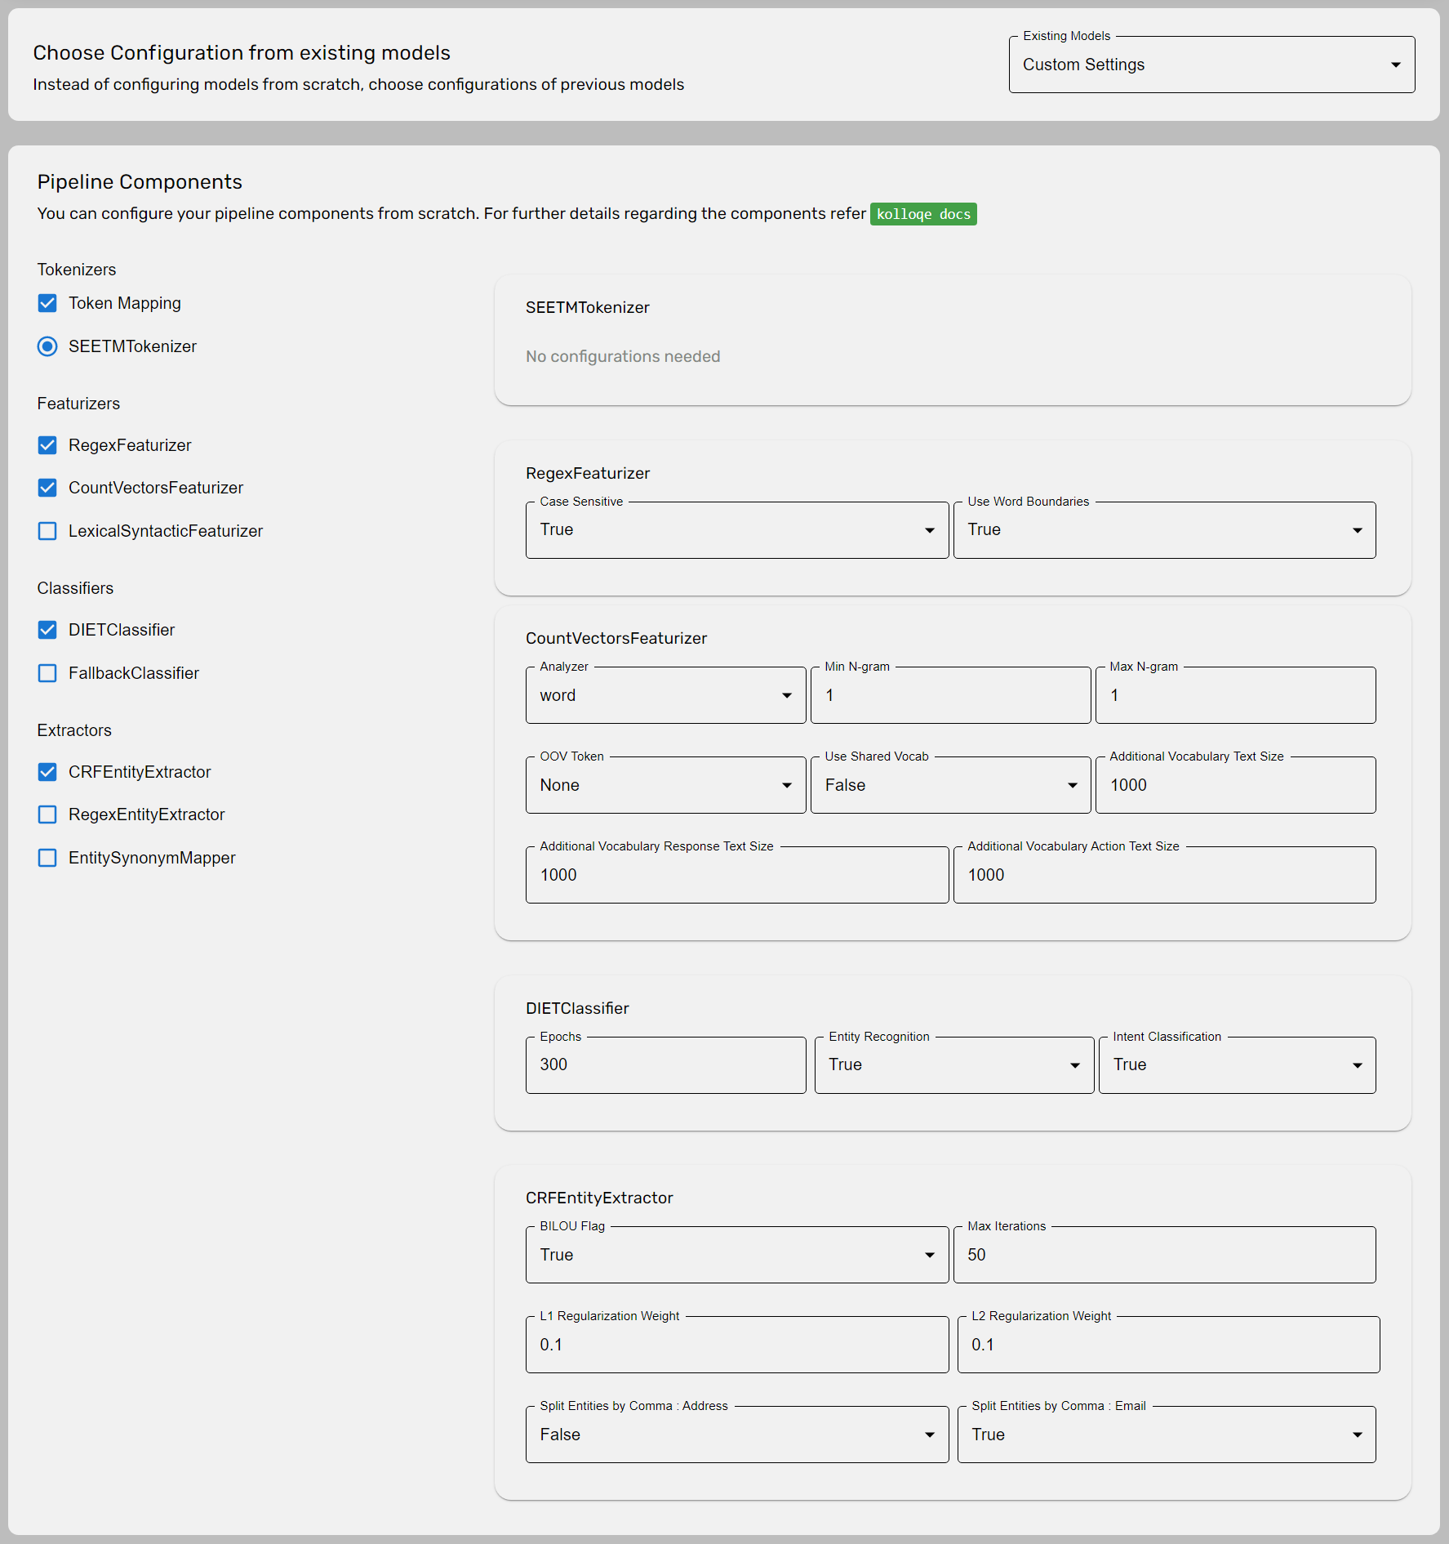
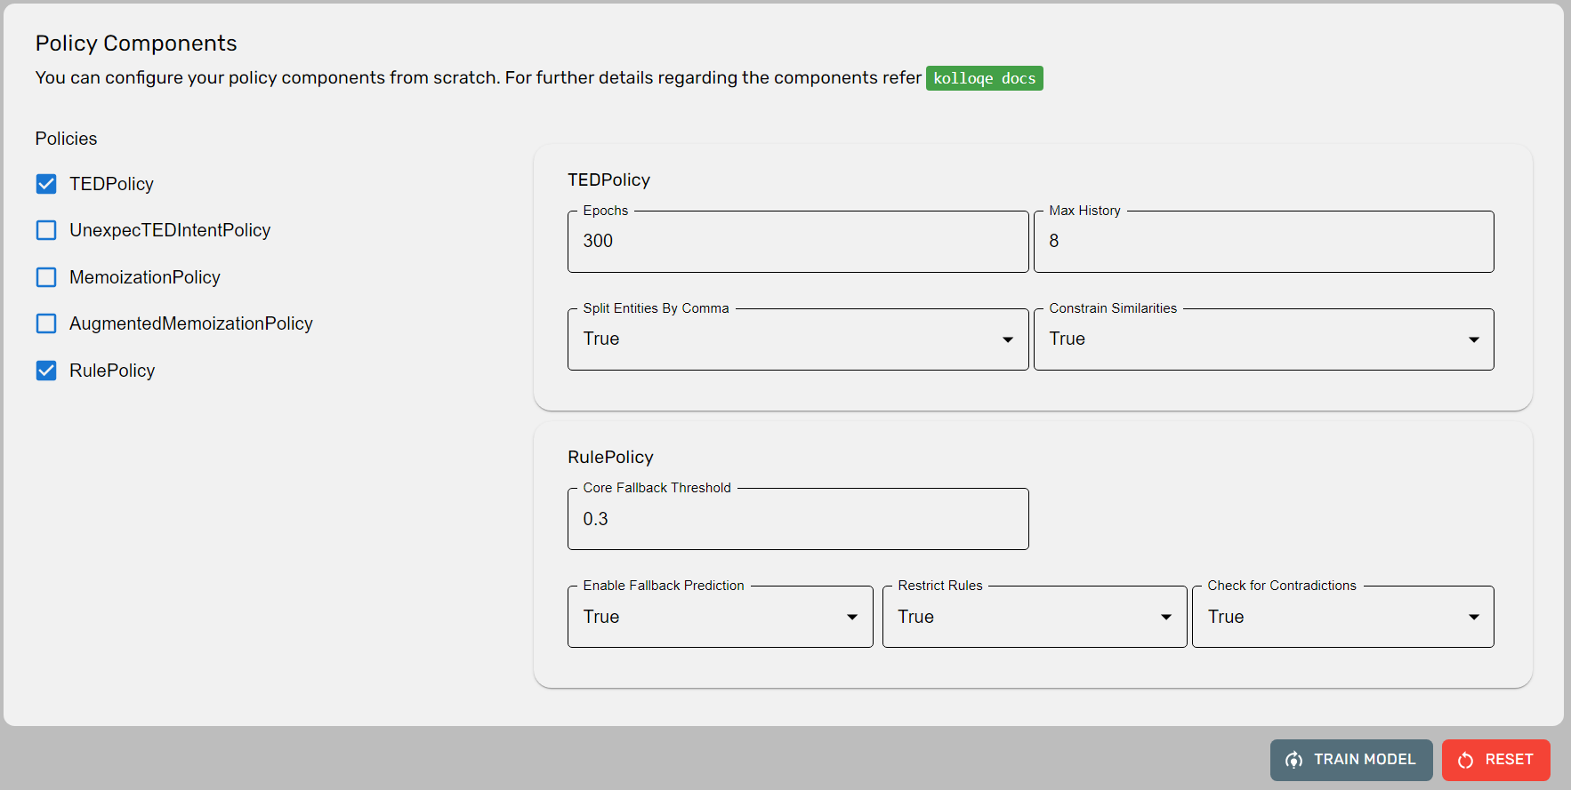
Version 2.0
Provides the option to set the pipeline and policy configurations using configurations from existing models
Added a custom tokenizer(SEETM) for token mapping
Added links to kolloqe documentation containing explanations for provided components

Slide 28
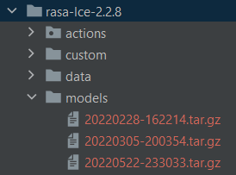
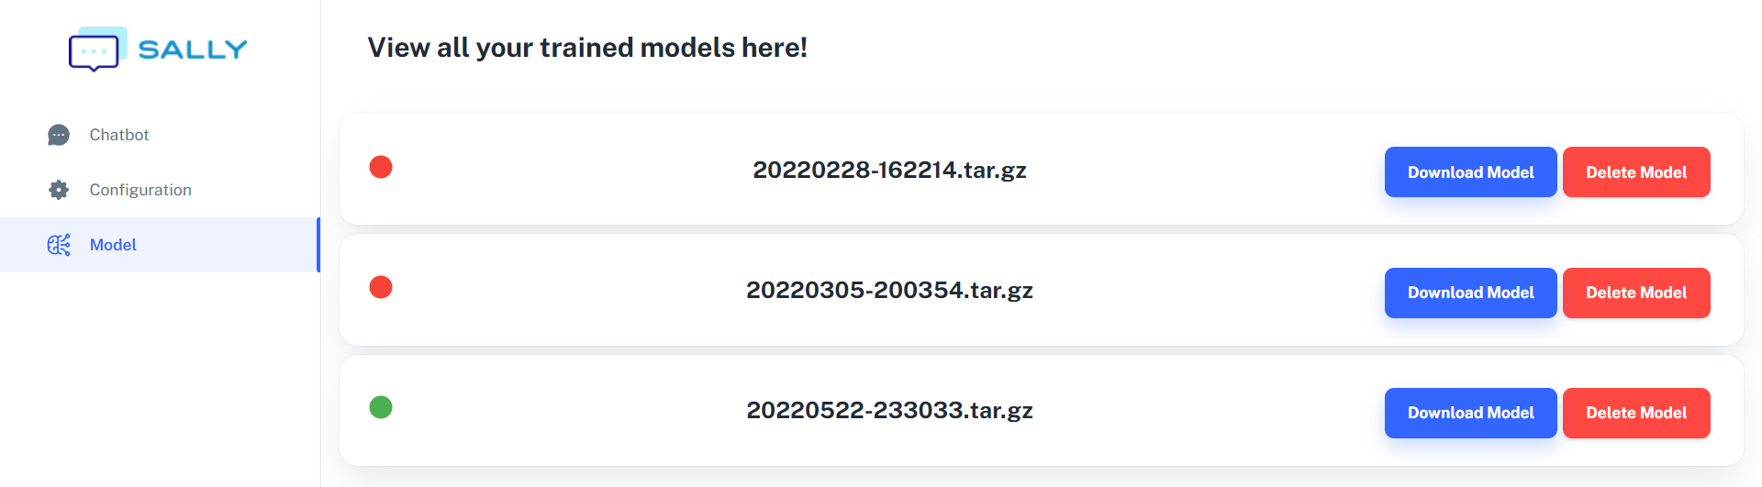
Trained
Models

Slide 29
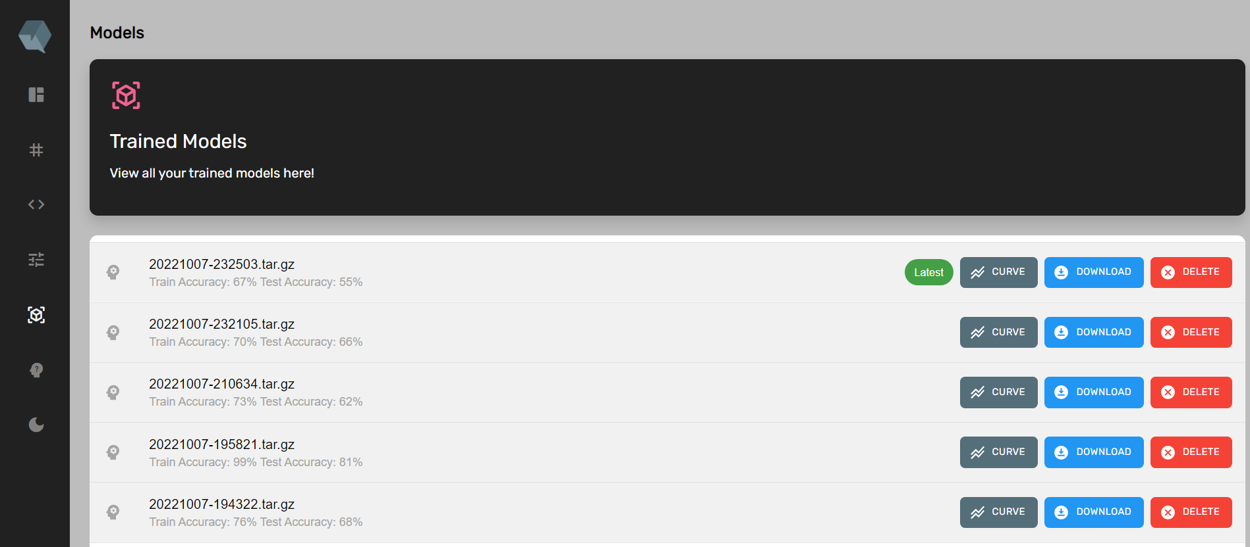
Trained Models
Version 2.0
Train and Test accuracy of each model is displayed
Added option to view learning curves for each trained model

Slide 30
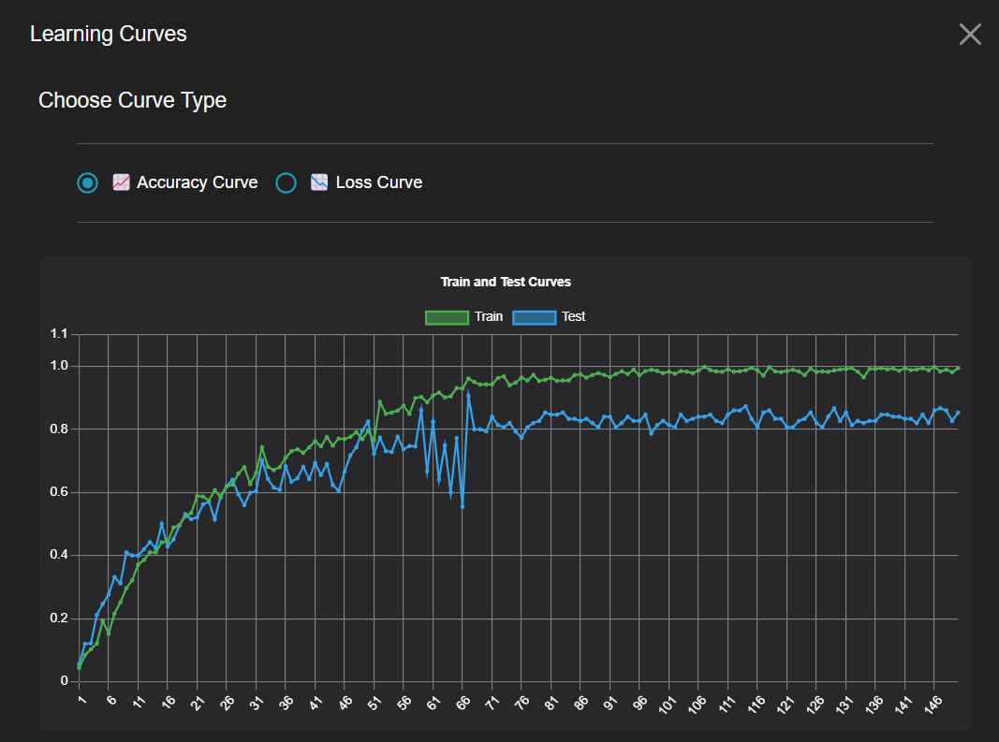

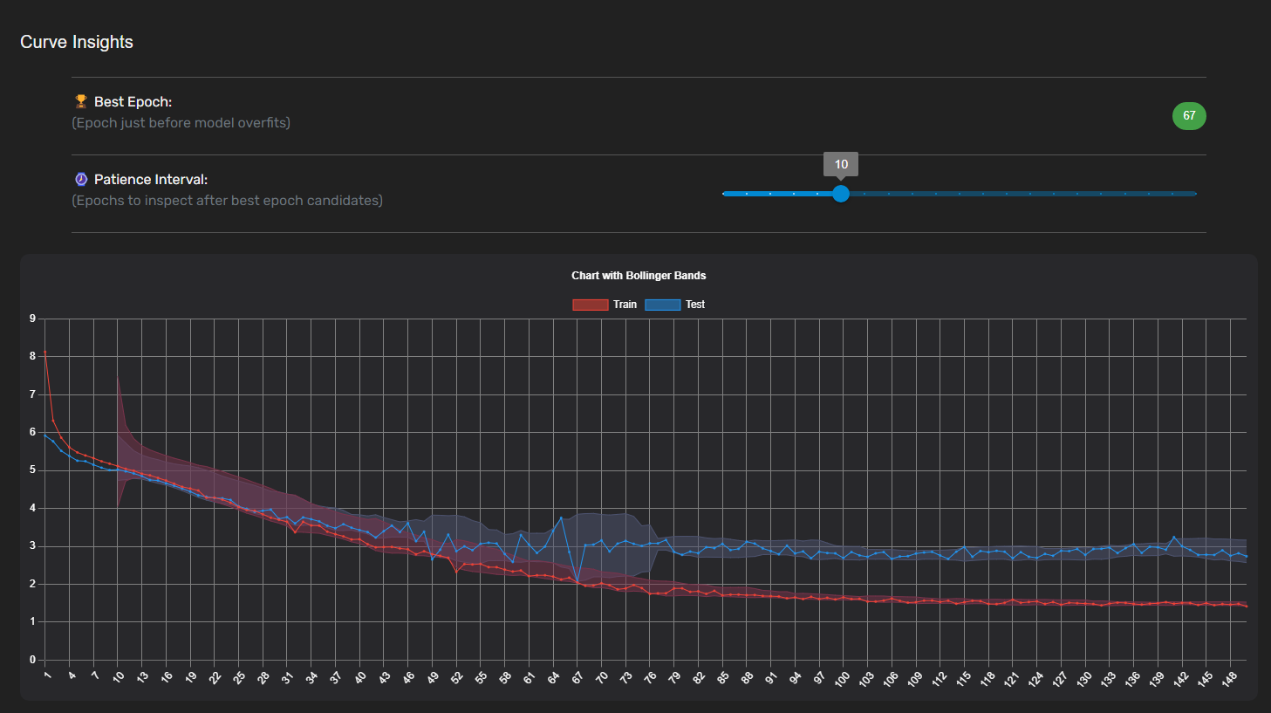
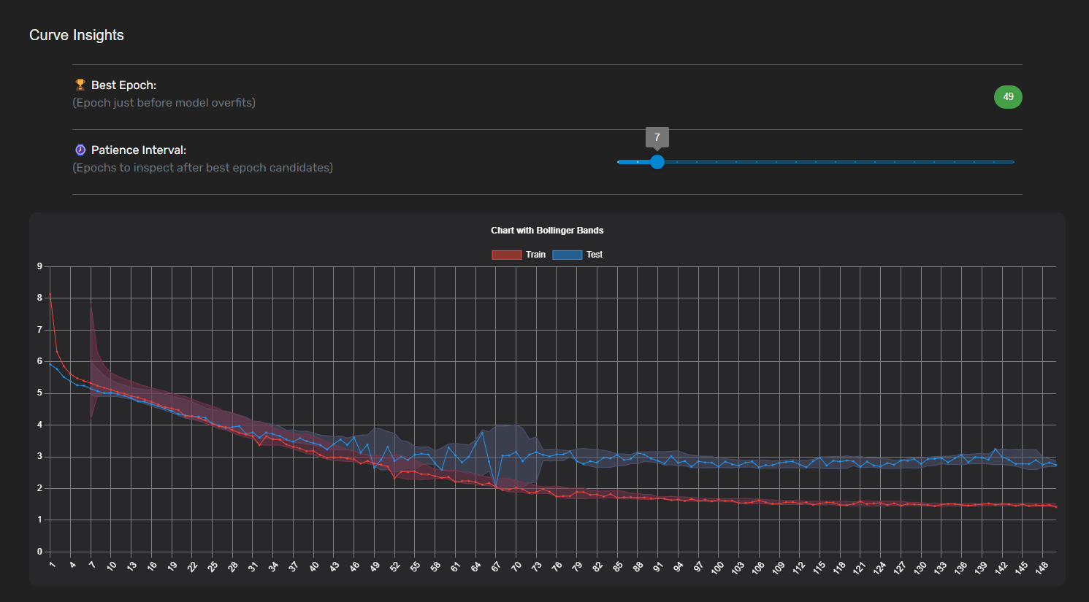
Learing
Curves
Option to view accuracy and loss curve for evaluations
Best epoch is suggested based on patience interval selected

Slide 31
Data Improvement Requirements
Functional Requirements
Non-Functional Requirements
Should be able to choose pipeline and policy components and train models without knowing what dependencies they require and the required order
Should increase the efficiency of training a model by reducing errors using the UI compared to manually typing the pipeline and policy components
Should be able to view and evaluate learning curves of
trained models
Should reduce the time consumed to create the pipeline and policy components by reducing the
need to type by increasing clickable components
Should be able to suggest the best epoch to train a model after evaluating the loss curve of a trained model.

Slide 32

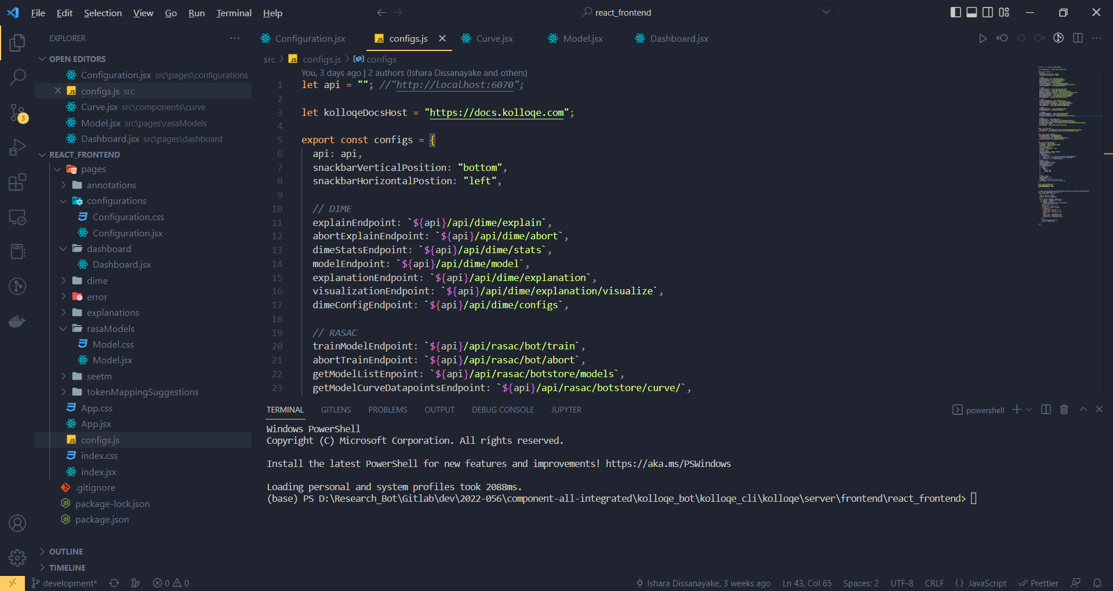

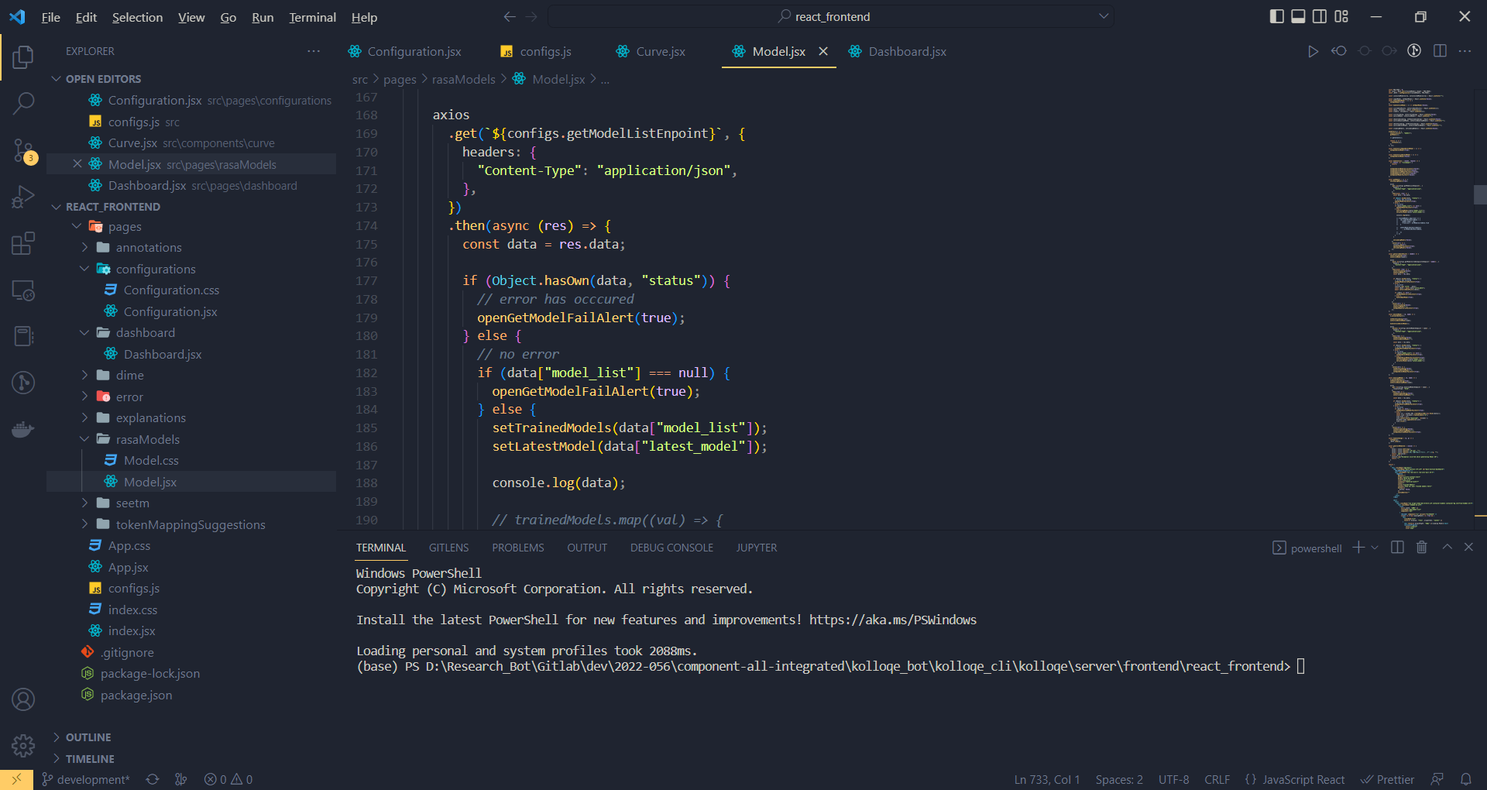
Best
Practices
Maintain a properties file for the front-end

Slide 33
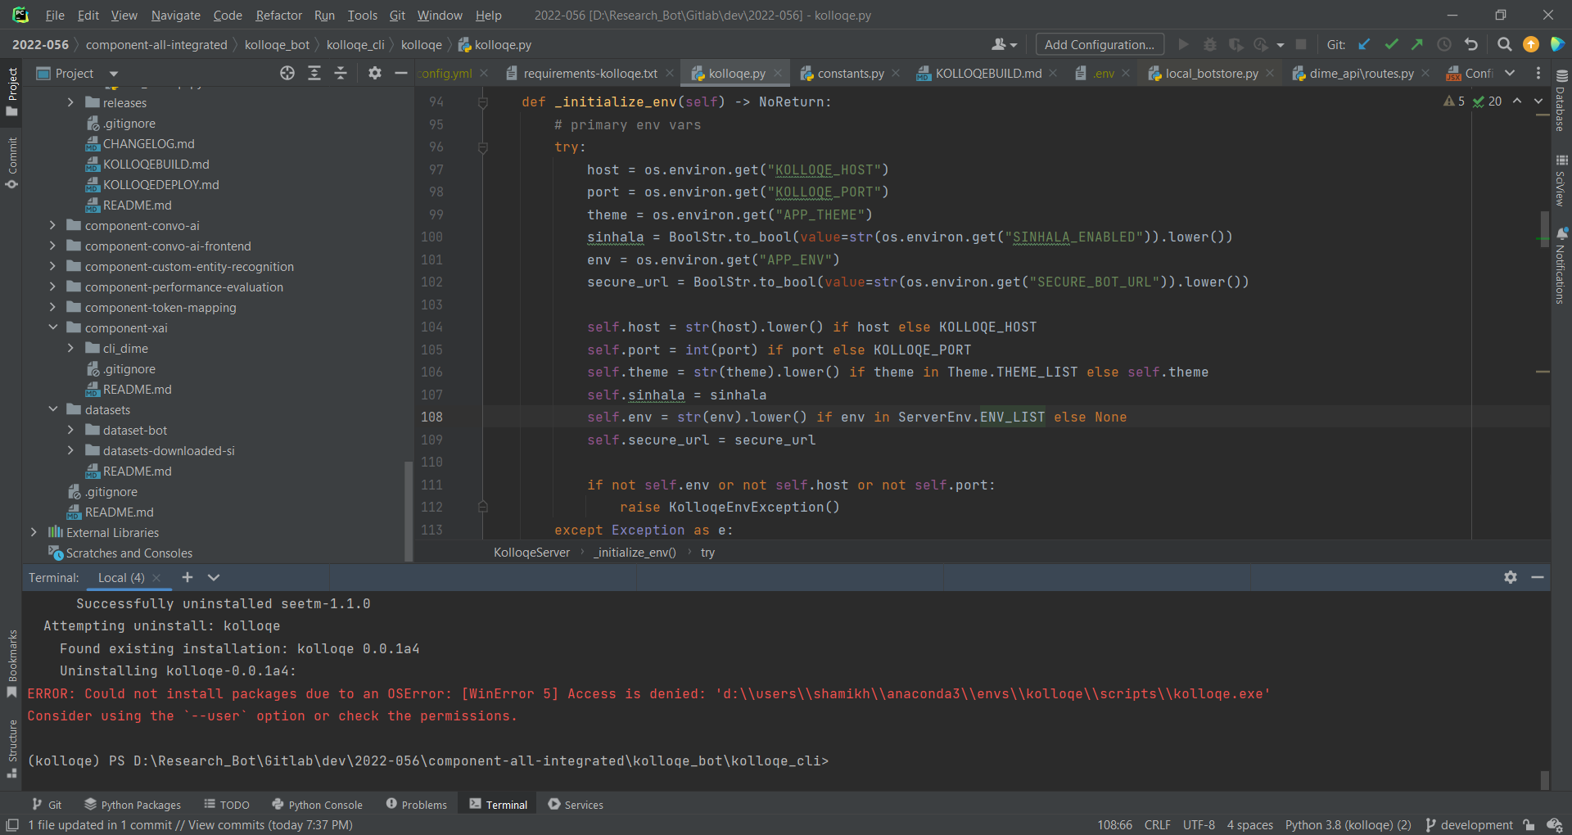
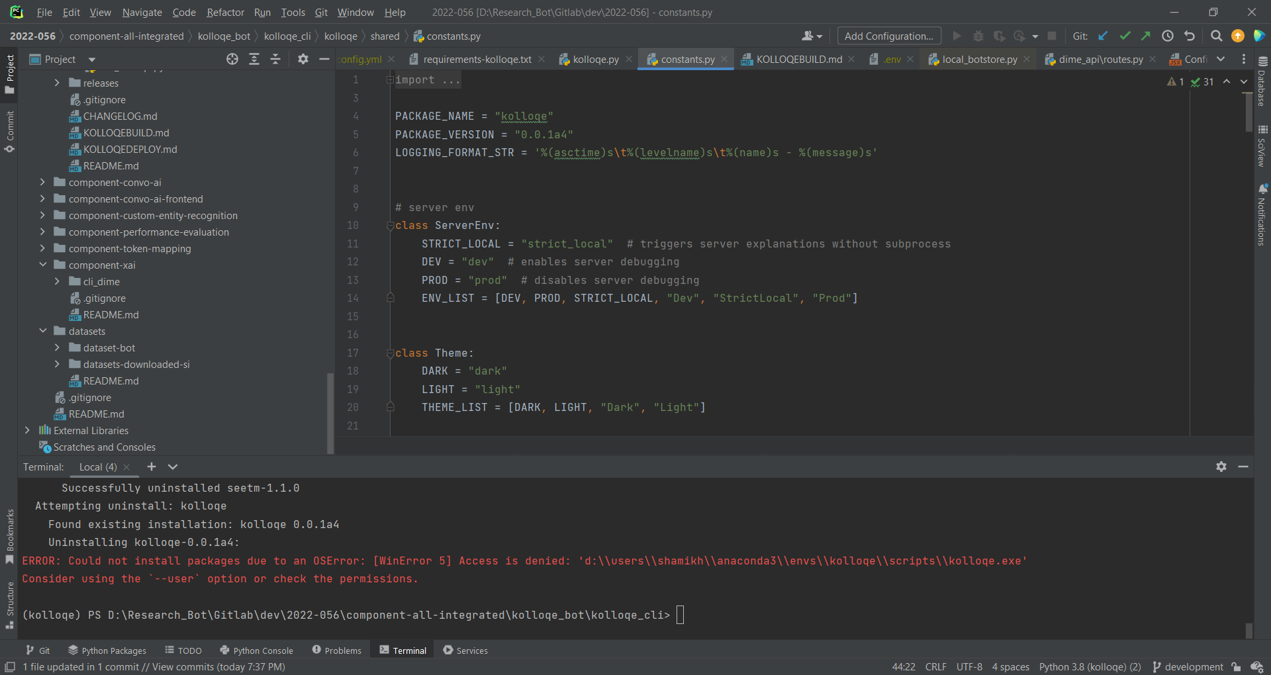
Best
Practices
Maintain a constants file for the back-end

Slide 34
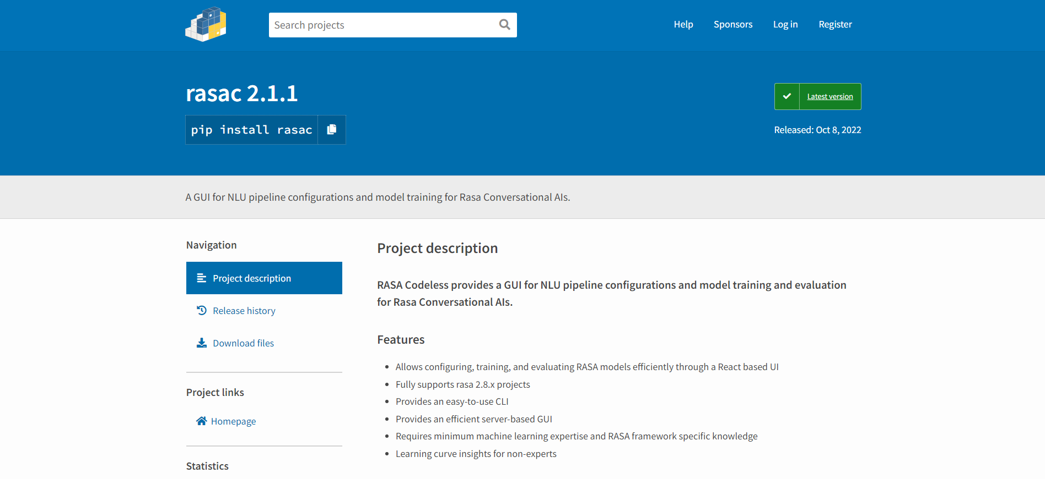
Additional
Work
Publishing individual component PyPi

Slide 35
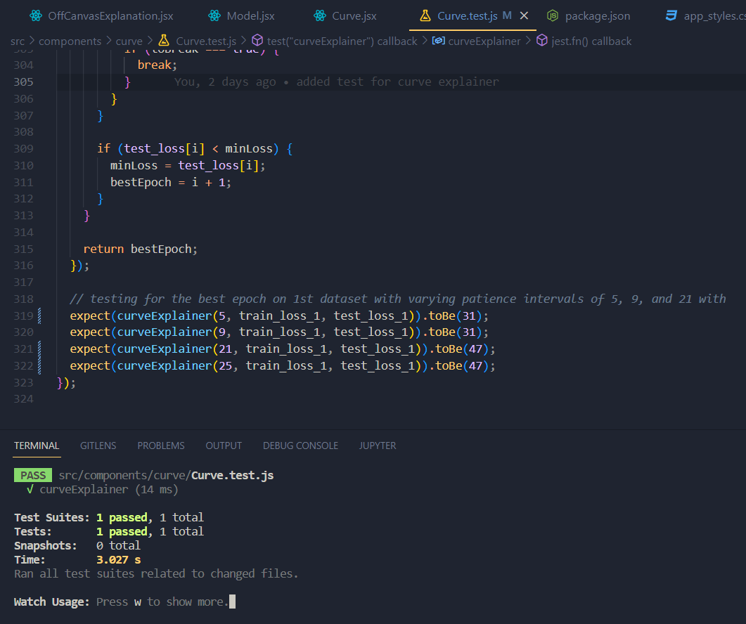

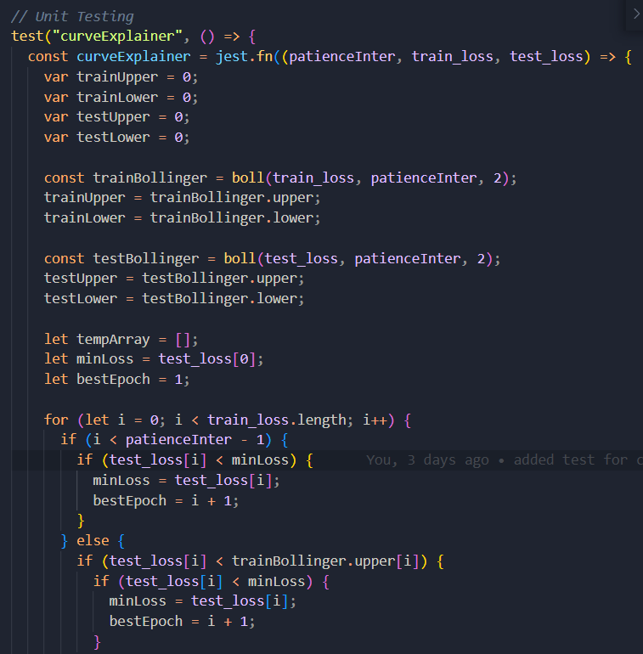
Test
Classes

Slide 36

Sub
Objectives
95% * 0.1
Developing a solution for non-technical users to configure and efficiently retrain machine learning models.
100% * 0.6
100% * 0.3
Developing a solution for non-technical users to view all train models and evaluate them
Developing an algorithm to identify what the best epoch is to train a model and suggesting it in the UI.
99%
Overall completion = (objective completion) x (objective weight) =

Slide 37

Work Breakdown Structure
1
Data Preparation
Building Conversational AI
Algorithm Development
4
Implementation
Deployment
2
3
5
Data Collection
Add Training Data
Read TensorBoard Results
Integrate LCE with Rasa
Update the GIT Repository
Data Augmentation
Build NLU pipeline
Develop Learning Curve Explainer algorithm to interpret TensorBoard Results
Build the Frontend
Set up Cloud Instance
Data Deduplication
Decide number of validation data points
Implement code-less Maintenance
Deploy Docker Containers
Data Preprocessing
Build Docker & Docker-compose files
Test LCE and Code-less Maintenance after Deployment
Enable TensorBoard
Build the LCE Package
Train a model
Build a Locally executable Server
Build Caddy and NGINX Servers
Testing NLU Model
Integrate component UI with the Main UI
Completed
In-progress (90% - 100%)
Pending
Implement kolloqe documentation

Slide 38


Technologies
Frontend Development
Backend Development
Project Management
React
Python
TensorBoard
Git
GitLab
GitHub
Rasa
Flask
PyPi

Slide 39

References
[1]. T. Bocklisch, J. Faulkner, N. Pawlowski, en A. Nichol, “Rasa: Open source language understanding and dialogue management”, arXiv preprint arXiv:1712. 05181, 2017.
[2]. “Introduction to rasa X,” Open source conversational AI, 10-Dec-2021. [Online]. Available: https://rasa.com/docs/rasa-x/. [Accessed: 22-Jan-2022].

Slide 40

97.5%
SEETM: Sinhala-English
Equivalent Token Mapper
Developing rule-based approaches to process code-mixed textural data and make word embeddings models lightweight using token mapping.
Jayasinghe D.T.
IT19075754
Data Science

Slide 41
SEETM
1
2

Slide 42


1
Problem:
How can I type Sinhala and English words together?
No Sinhala English Code-switching Typing Support in Chatbots!

Slide 43


Solution Found !
1

Slide 44

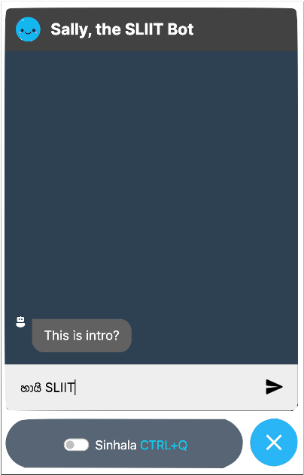
Sinhala-English code-switchable Keyboard Interface
Code-Switching
Library Membership
එකට apply
කරන්නේ කොහොමද?

Slide 45





Research Flow
Web Chat
Component
Sinhala-English Keyboard Interface
Users
Conversational AI User Interface
Get Data on Key Press/ Key Up/ Key Down Events
Apply Rules in order
Return the converted Text

Slide 46
Keyboards
Comparison
Keyboard Name | Default (Misleading character Map) | Changes
Helakuru Keyboard (හෙළකුරු) | Backspace + a → ා c → ක් u → ෞ (when re-enter) ou → ඖ Q/q → ද් | Backspace + a → අ c → ච් u → උ au → ඖ Q/q → (Shortcut) (dh → ද්)

Slide 47
Keyboards
Comparison
Keyboard Name | Default (Misleading character Map) | Changes
UCSC Unicode Real-Time Font Converter | c → c q → ඣ් Q → Q U → U V → V E → E F → F H → H M → M O → O S → S W → W x, X → x z→ z | c → ච් Q/q → (Shortcut) U → උ V → ව් E → ඓ F → ෆ් H → ඃ M → ම් O → ඖ S → ස් X → ඞ් x → ං W → ව් z → ර්‍

Slide 48


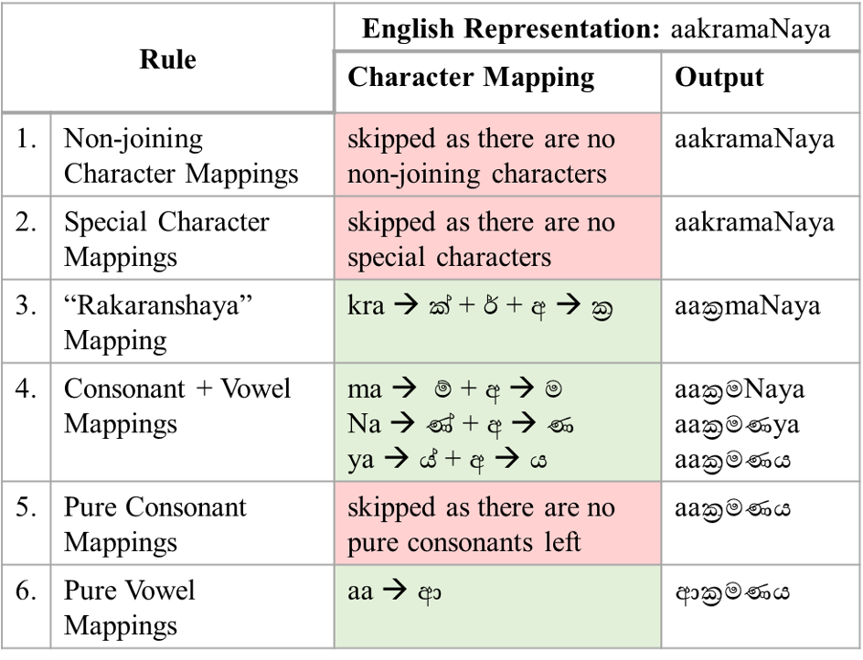
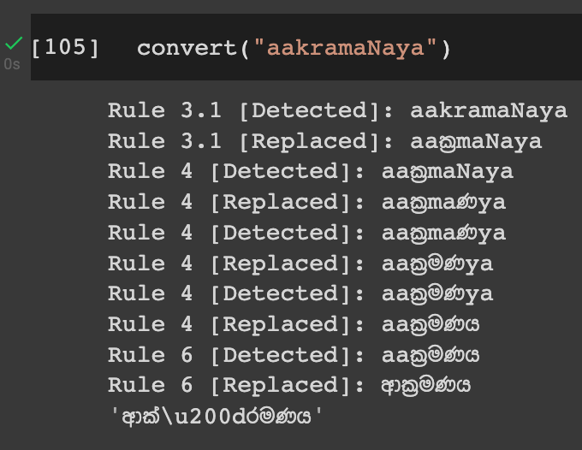
Keyboard Interface Ruleset
Rule Activation
ආක්‍රමණය

Slide 49
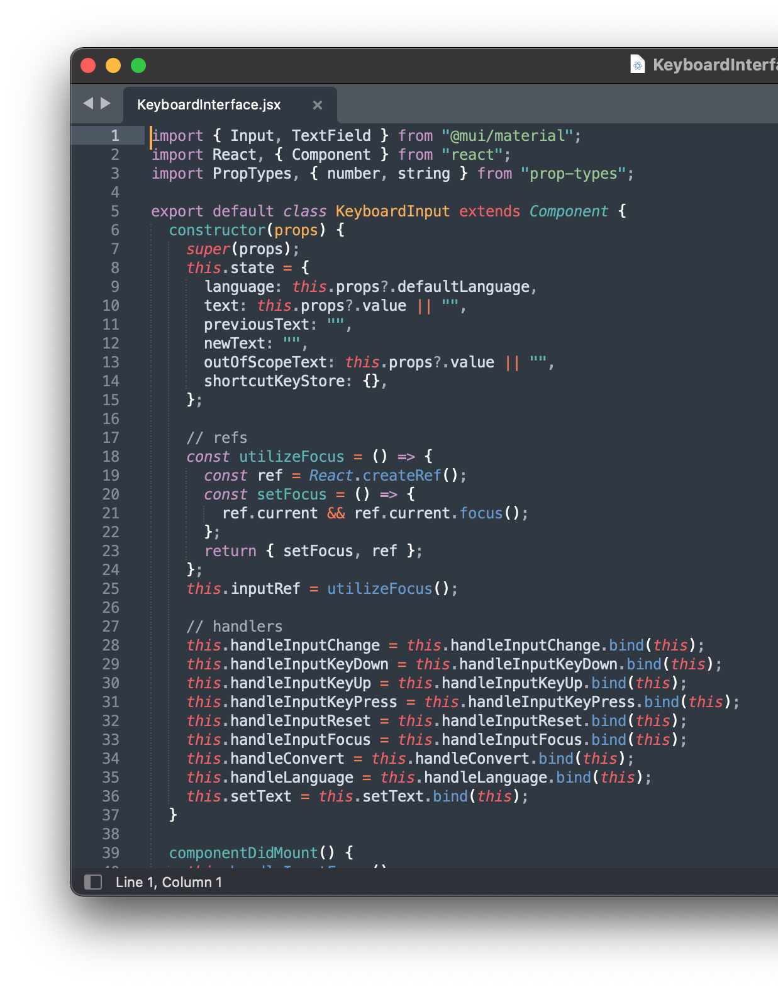
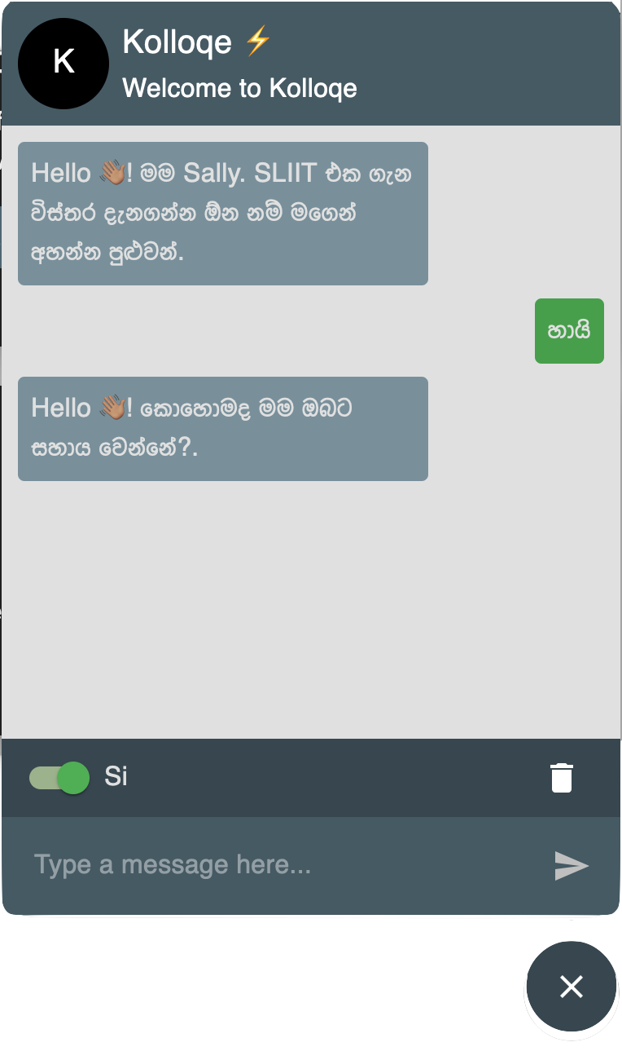
React based Keyboard Interface
Keyboard works on chatbot

Slide 50
Information technology
2
Problem:
Equivalent words in Code-Switching datasets
IT
Information technology
අයිටී
තොරතුරු තාක්ෂණය
isn’t this similar?
ML models see equivalent words as different features!

Slide 51
Solution Found !
2

Slide 52

Translating approach
Pronunciation based approach

Slide 53
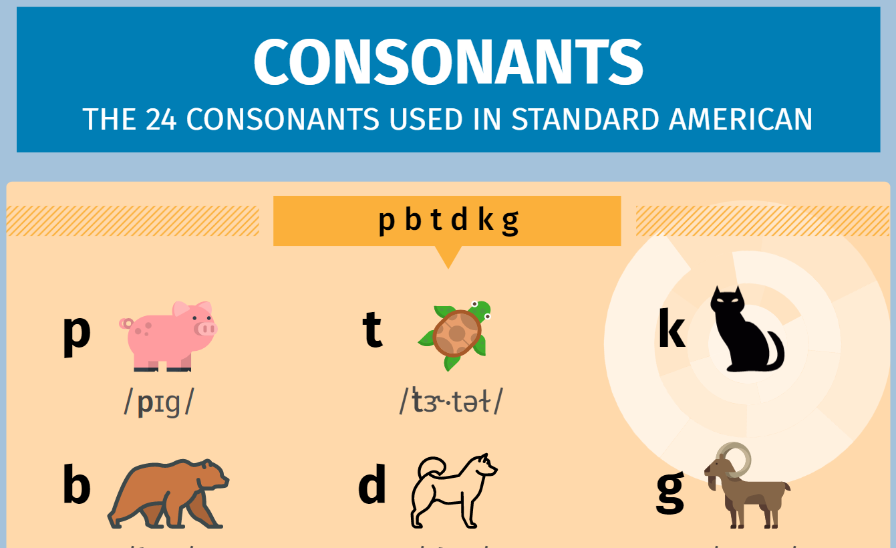
IPA Mapping
eɪ ඒ | aɪ අයි | aʊ අව් | ɔ අව් | ɔɪ ඕ | oʊ ඕ | æ ඇ
I ඊ | u ඌ | ɪ ඉ | ʊ උ | ə අ | ɛ එ | ɝ අර් | æ ඈ | ɑ ආ
tʃ ච් | dʒ ජ් | p ප් | b බ් | t ට් | d ඩ් | k ක් | g ග් | θ ත්
ð ද් | f ෆ් | v ව් | s ස් | z ස් | ʃ ශ් | ʒ ෂ් | w ව් | m ම්
n න් | ŋ න්ග් | ɹ ර් | r ර් | j ය් | h හ් | ɫ ල් | l ල්
https://americanipachart.com/

Slide 54
Translating approach
Pronunciation based approach
User defined rule-based map

Slide 55
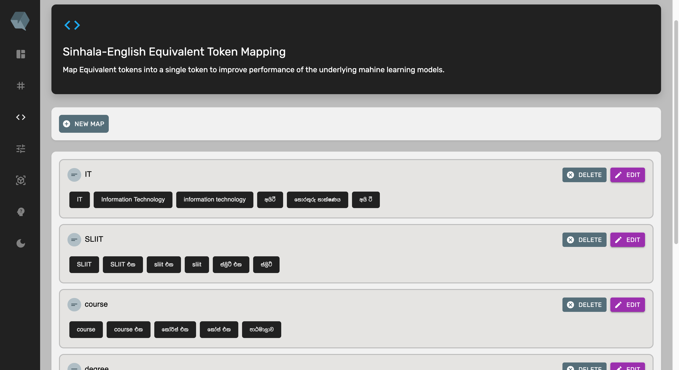
Equivalent Token Mapping
Rule | Equivalent Tokens
උපාධි | උපාධි, degrees, ඩිග්‍රි, ඩිග්‍රිස්, ඩිග්‍රී, ඩිග්‍රීස්
sliit | sliit, SLIIT, ශ්‍රී ලංකා තොරතුරු තාකෂණ ආයතනය, ස්ලිට්, ස්ලිට් එක

Slide 56
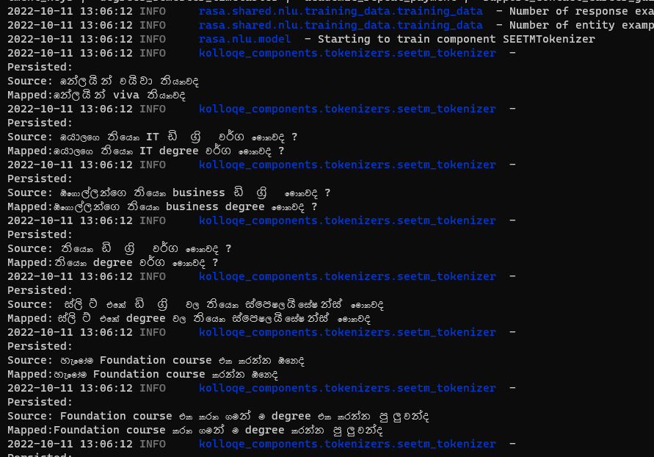
Token Mapping In action
OVV Handling
Same Vector (Features)

Slide 57


Specific
Objective
Assigning the same word vector to equivalent words in a Sinhala-English code-switched text corpus

Slide 58

Sub
Objective
95% * 0.4
100% * 0.5
OOV words Handling in
word embeddings
Bilingual Keyboard Interface
95% * 0.1
Lightweight
Word Embedding Models
Overall completion = (objective completion) x (objective weight) =
97.5%

Slide 59
Work Breakdown
Structure
SEETM
1
Data Preparation
SEETM Algorithm Development
Sinhala-English Code-Switching Keyboard Interface
4
Implementation
Deployment
2
3
5
Data Collection
Develop Sinhala-English Character Map
Develop the Keyboard Interface Using Keystroke Mapping
Integrate SEETM with Rasa
Update the GIT Repository
Data Augmentation
Build Docker Images
Set up GCP Instance
Develop Equivalent Token Mapping Algorithm: SEETM
Data Deduplication
Utilizing the Character Map within the Keyboard Interface
Write Docker Compose Configs
Deploy Docker Containers
Data Preprocessing
Evaluate Token Mapping Manually
Build Caddy and NGINX Servers
Test SEETM and Keyboard Interface after Deployment
Training a Word2Vec Model
Enable Efficient Language Switching
Integrate component UI with the Main UI
Evaluating Token Mapping Effect on Word2Vec Model
Completed
In-progress (90% - 100%)
Pending

Slide 60

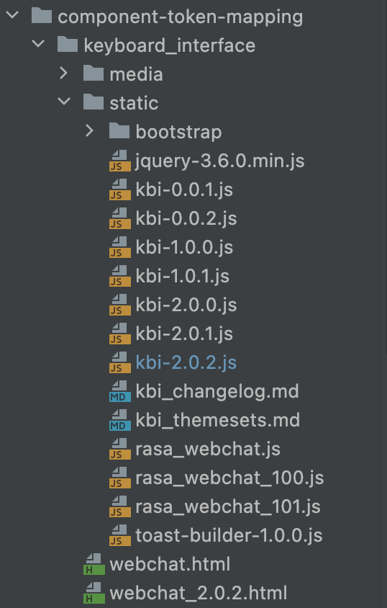
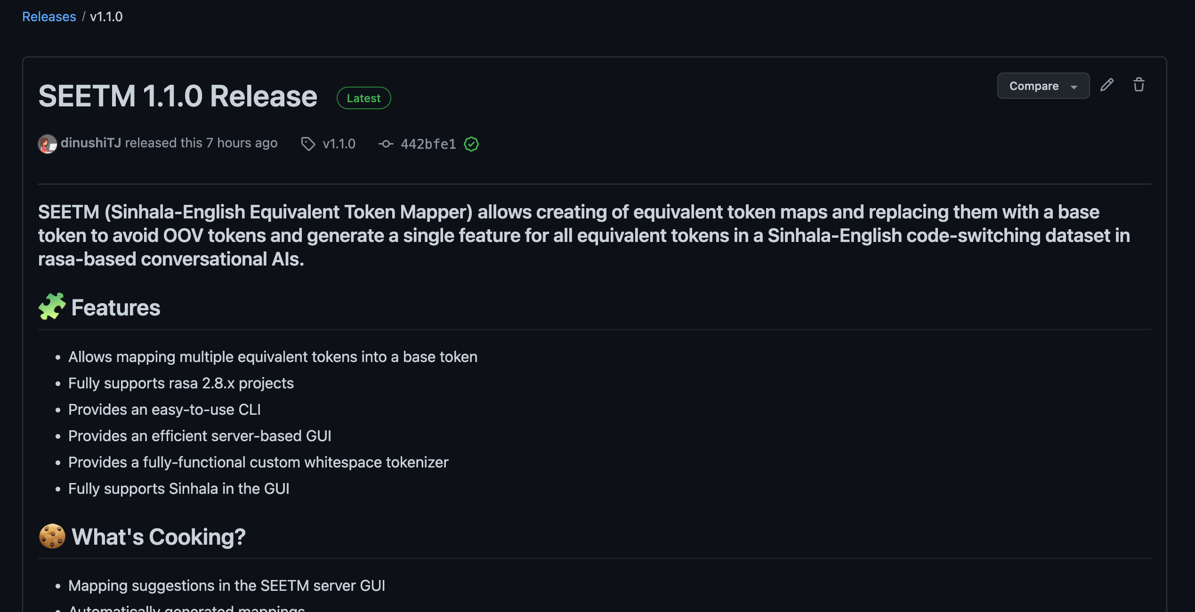

Best Practices
1
Semantic Versioning Releases
2
Implemented
Versions

Slide 61

Functional Requirements
Ability to type in Sinhala using an English keyboard.
Ability to switch between typing Sinhala and English
Ability to type emojis if required
SEETM should handle out-of-vocabulary words in Word2Vec models when at least one of the representations of equivalent tokens are present in training data.

Slide 62

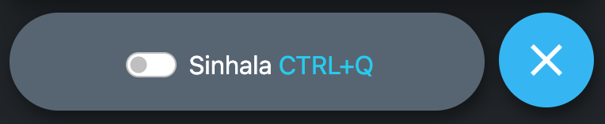
Non-Functional Requirements
Efficiency
Usability
Reliability
Scalability
Modularity

Slide 63

References
[1]. T. KasthuriArachchi and E. Y. A. Charles, "Deep Learning Approach to Detect Plagiarism in Sinhala Text," 2019 14th Conference on Industrial and Information Systems (ICIIS), 2019, pp. 314-319, doi: 10.1109/ICIIS47346.2019.9063299.
[2]. A. Kugathasan and S. Sumathipala, "Standardizing Sinhala Code-Mixed Text using Dictionary based Approach," 2020 International Conference on Image Processing and Robotics (ICIP), 2020, pp. 1-6, doi: 10.1109/ICIP48927.2020.9367353.
[3]. https://americanipachart.com/

Slide 64


DIME: Dual Interpretable
Model-Agnostic Explanations
Using global explanations to generate local interpretations
in intent classification models using explainable AI
99%
Dissanayake D.M.I.M.
IT19069432
Data Science

Slide 65

Functional Requirements
DIME should provide methods to calculate global and local explanations
DIME should provide a local server as a visualization tool
DIME should be applicable to any text classification model that outputs confidence scores for predictions
DIME should provide adjustable configurations required for explanations
DIME should utilize caching to optimize calculations

Slide 66


Generating DIME Explanations
Request Model Explanations (XAI)
dime_config.yml
Developers and Testers
DIME Web Server/ CLI/ Python API
Getting Data instance and user configs
Trained RASA Model
Retrieve default DIME Configs
DIME Cache Directory
Generate DIME Explanations
DIME Explanations Directory
Visualize DIME Explanation
Download Explanation as a JSON file

Slide 67

Non-functional Requirements
Efficient Calculations
Reliable Explanations
Simple & Interpretable Visualizations
Modular package

Slide 68

DIME Algorithm
Input Data
Tokenize
Preprocess
Calculate Global feature importance per token
Calculate local feature importance
Feature Selection
Cache
Explanation object
Persist as JSON
Visualize

Slide 69
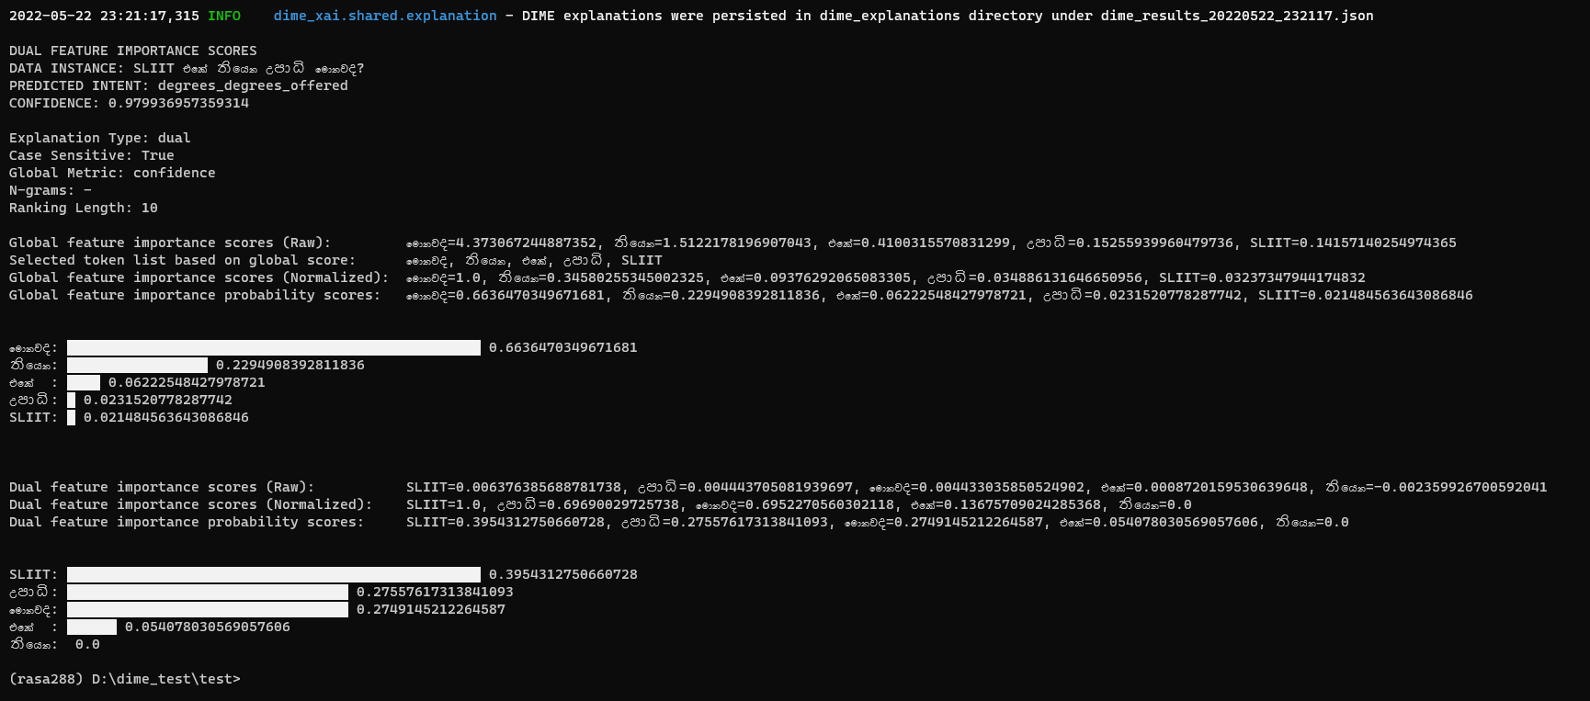
DIME Algorithm cont.

Slide 70
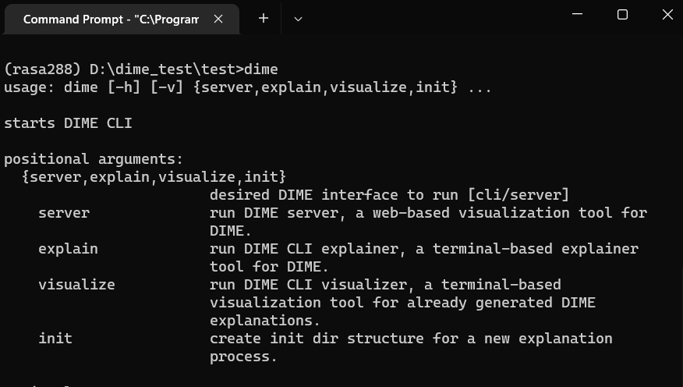

DIME Interfaces
CLI Interface
(terminal)

Slide 71
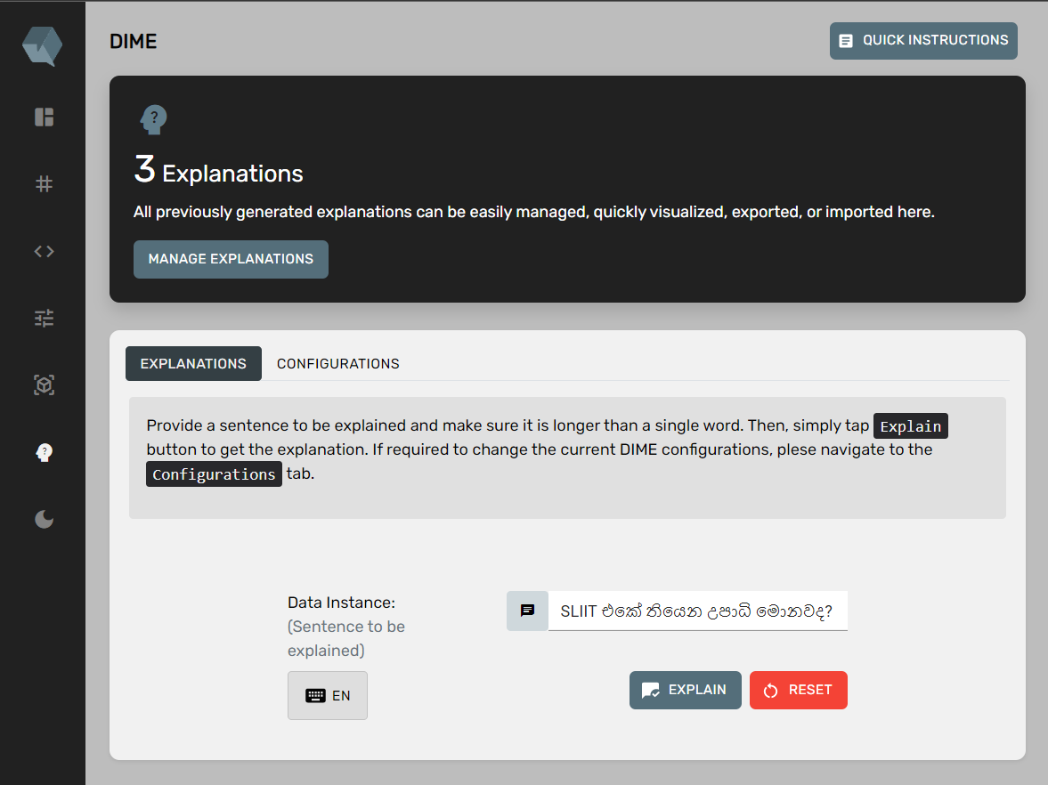
DIME Interfaces
GUI Interface (web)

Slide 72
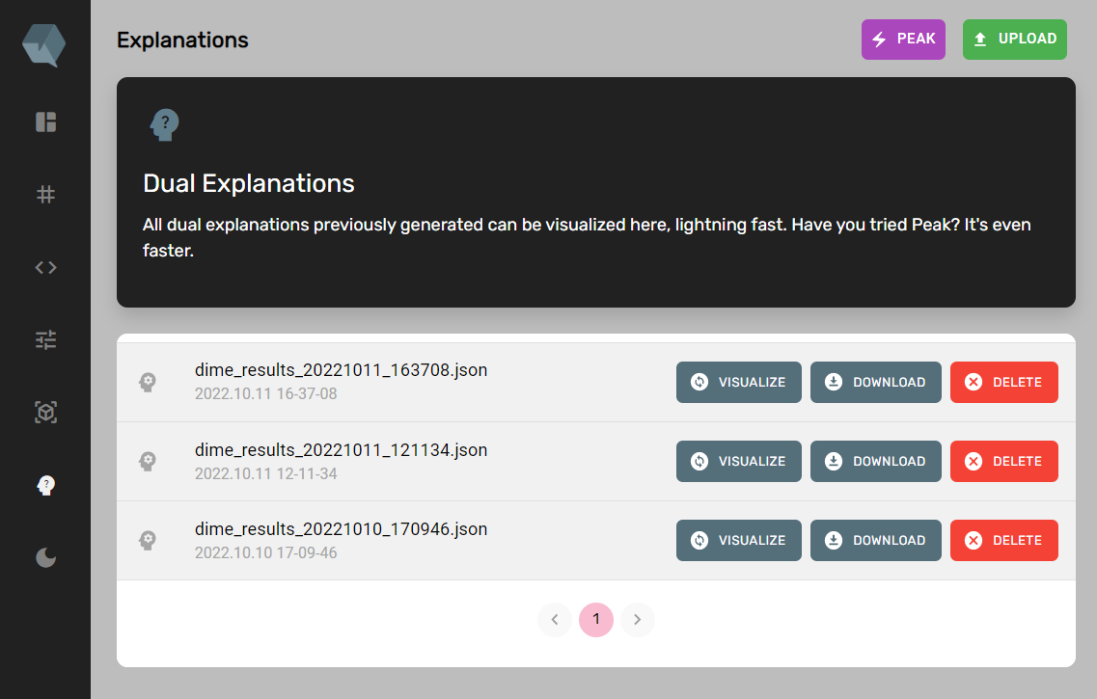
DIME Interfaces
GUI Interface (web)

Slide 73
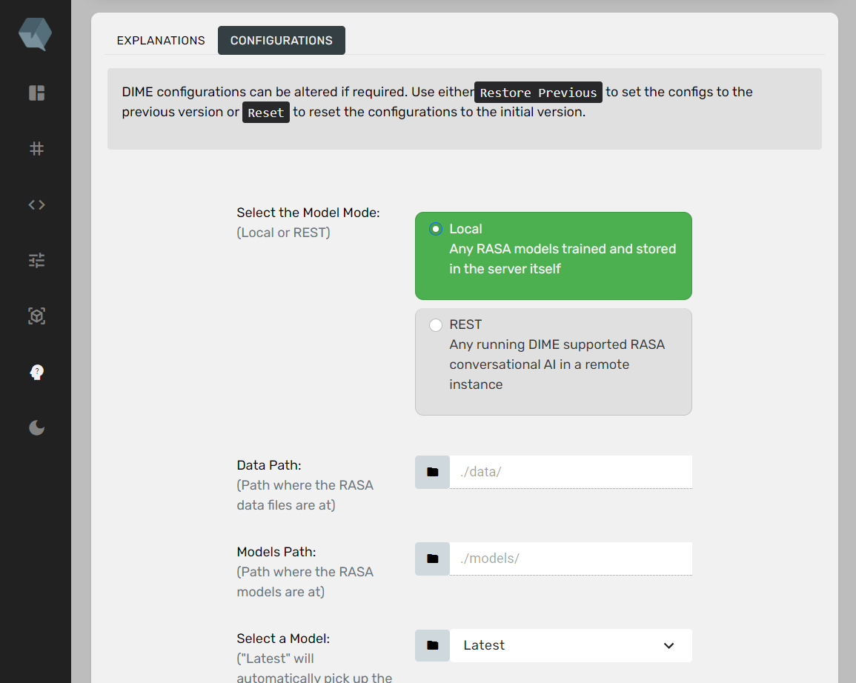
DIME Interfaces
GUI Interface (web)

Slide 74
Best Practices
The Code
Releases
Threading
Git
GitLab
GitHub
Docstrings
PyPI
PEP8
Test PyPI

Slide 75
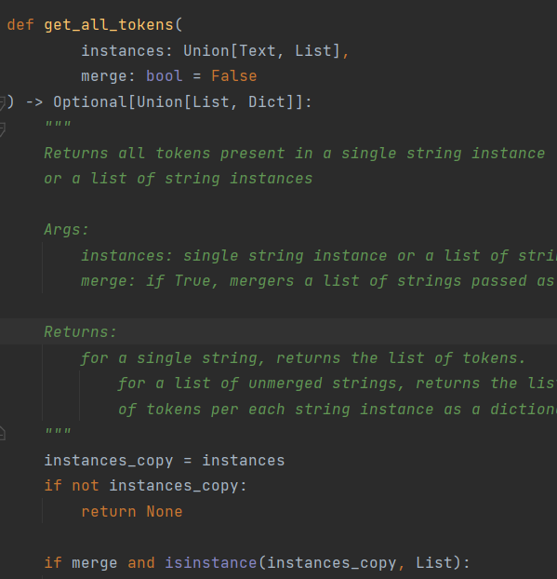
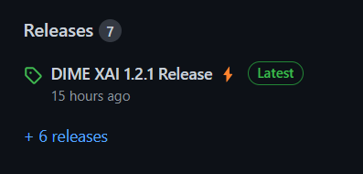

Docstrings & PEP8
Versioning
Test PyPI alpha version release

Slide 76


Vulnerability and Security Testing with Snyk

Slide 77


https://pypi.org/manage/project/dime-xai/releases/
DIME Python Package
Open-source
Rasa Compatible
https://github.com/DIME-XAI/dime-xai

Slide 78

Specific Objective
Develop DIME, an Explainable AI approach to deliver local model explanations with the help of global feature importance.

Slide 79

Sub Objectives
100% * 0.4
95% * 0.15
100% * 0.05
Find Global and Local Explanations logically
Develop a python package for DIME
Modify DIET intent classifier to get all confidence scores
100% * 0.3
100% * 0.1
Visualize explanations in an interpretable manner
Integrate DIME with Rasa seamlessly
Overall completion = (objective completion) x (objective weight) =
99.25%

Slide 80
DIME
1
Data Preparation
Conversational AI Building
Algorithm Development
4
Implementation
Deployment
2
3
5
Data Collection
Add Training Data
Global Feature Importance
Integrate DIME with Rasa
Update the GIT Repository
Data Augmentation
Build NLU pipeline
Local Model Explanations
Build Docker Images
Set up GCP Instance
Data Deduplication
Modify DIET Classifier
Build the DIME Core Package
Write Docker Compose Configs
Deploy Docker Containers
Data Preprocessing
Train a model
Develop local Visualizations Server
Build Caddy and NGINX Servers
Test DIME after Deployment
Integrate component UI with the Main UI
Work Breakdown
Structure
Compare and Evaluate DIME explanations with LIME
Completed
In-progress (90% - 100%)
Pending

Slide 81

References
[1]. M. T. Ribeiro, S. Singh, C. Guestrin, “‘why should I trust you?’: Explaining the predictions of any classifier,” 16 Feb 2016. [Online]. Available: https://arxiv.org/abs/1602.04938
[2]. S. Lundberg, S. Lee, “A Unified Approach to Interpreting Model Predictions,” 2017. [Online]. Available: https://arxiv.org/abs/1705.078744
[3]. T. Bunk, D. Varshneya, V. Vlasov, A. Nichol, “DIET: Lightweight Language Understanding for Dialogue Systems,” 2020. [Online]. Available: https://arxiv.org/abs/2004.09936

Slide 82





DEMO PACKAGE
ON PREM PACKAGE
$ 199.99 one time
2 Free Maintenance
($9.99 per additional call)
Bot Analytics + CDD
FREE for one month
10 Intents
2 API Integrations
Unlimited CDD Improvements
No Bot Analytics
Business Model
STARTER
CaaS PACKAGE
$ 9.99/Month
20 Intents
2 API Integrations
No Bot Analytics
Unlimited CDD Improvements
PRO
$ 34.99/Month
180 Intents
20 API Integrations
Bot Analytics
CDD
Sinhala Entity Annotation
GENIUS
$ 49.99/Month
400 Intents
50+ API Integrations
Bot Analytics Included
CDD + ML Packages

Slide 83

DEMO PACKAGE
FREE for one month
10 Question Categories
Entity Annotation
Model Evaluations
Model Explainability
$ 299.99 one time
1 Free Maintenance
($50.00 per additional call)
Question Categories
All ML Tools
ON PREM PACKAGE
STARTER
PRO
GENIUS
$ 9.99/Month
$ 34.99/Month
$ 49.99/Month
CaaS PACKAGE
100 Question Categories *
Entity Annotation
Model Evaluations
Model Explainability
20 Question Categories
Entity Annotation
Limited Model Evaluations
No Model Explainability
50 Question Categories
Entity Annotation
Model Evaluations
Limited Model Explainability

Slide 84



Chatbot development lifecycle
End-users
Consume chatbots
Organizations
Maintain chatbots
Chatbot Providers
Build chatbots
interact
test
develop
train
validate
deploy
release
* Maintenance is done constantly
after the release
maintain

Slide 85
Chatbot development lifecycle
End-users
Consume chatbots
Organizations
Maintain chatbots
Chatbot Providers
Build chatbots
interact
develop
train
validate
deploy
release
maintain

Slide 86









Model Explainability
Support for
Thank You
DialogFlow by Google
Rasa Open Source
Microsoft LUIS
Amazon Lex
NLP Tools for Sinhalese
Simple No-Code Development Console
Model Evaluations & Explainability

Slide 87


Any Questions

Slide 88

Demonstration

